Slide 1

Macroeconomics
Sixth Canadian Edition
Chapter 1
Introduction
Copyright © 2021 Pearson Canada Inc.
Notes:
If this PowerPoint presentation contains mathematical equations, you may need to check that your computer has the following installed:
1) MathType Plugin
2) Math Player (free versions available)
3) NVDA Reader (free versions available)

Slide 2
Chapter 1 Topics
What is macroeconomics?
GDP, economic growth, business cycles.
Macroeconomic models.
Understanding recent and current macroeconomic events.

Slide 3
What is Macroeconomics?
Models built to explain macroeconomic phenomena.
The important phenomena are long-run growth and business cycles.
Approach in this book is to build up macroeconomic analysis from microeconomic principles.

Slide 4
Gross Domestic Product, Economic Growth, and Business Cycles
Gross Domestic Product (GDP): the quantity of goods and services produced within a country’s borders over a particular period of time.
The time series of GDP can be separated into trend and business cycle components.

Slide 5
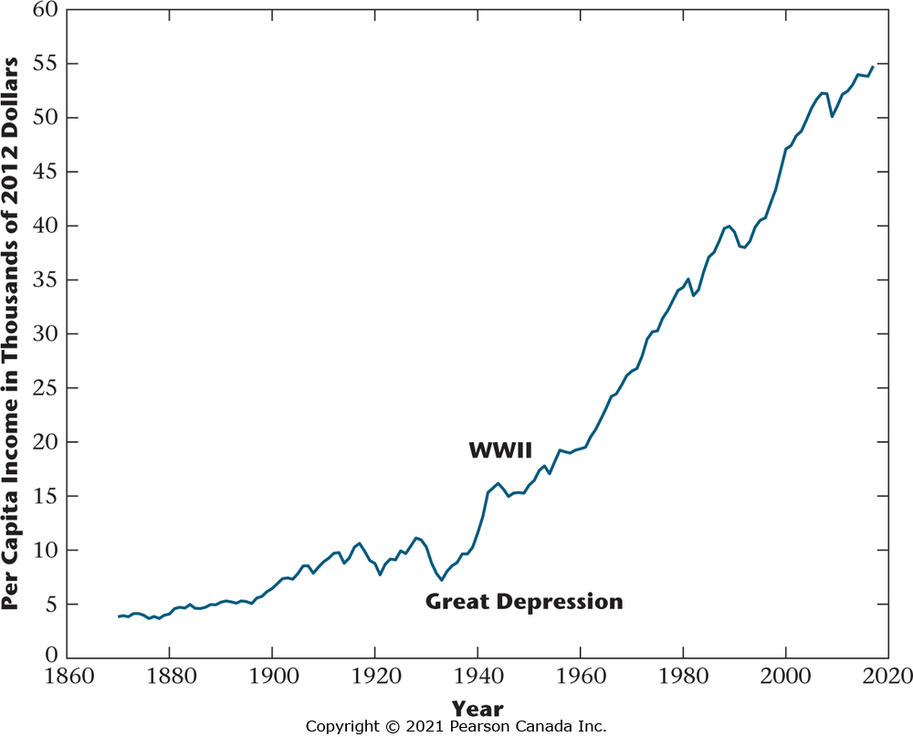
Figure 1.1 Per Capita Real GDP for Canada, 1870–2017 (2012 dollars)
Per capita real GDP is a measure of the average level of income for a Canadian resident. Two unusual, though key, events in the figure are the Great Depression, when there was a large reduction in living standards for the average Canadian, and World War II, when per capita output increased greatly.

Slide 6
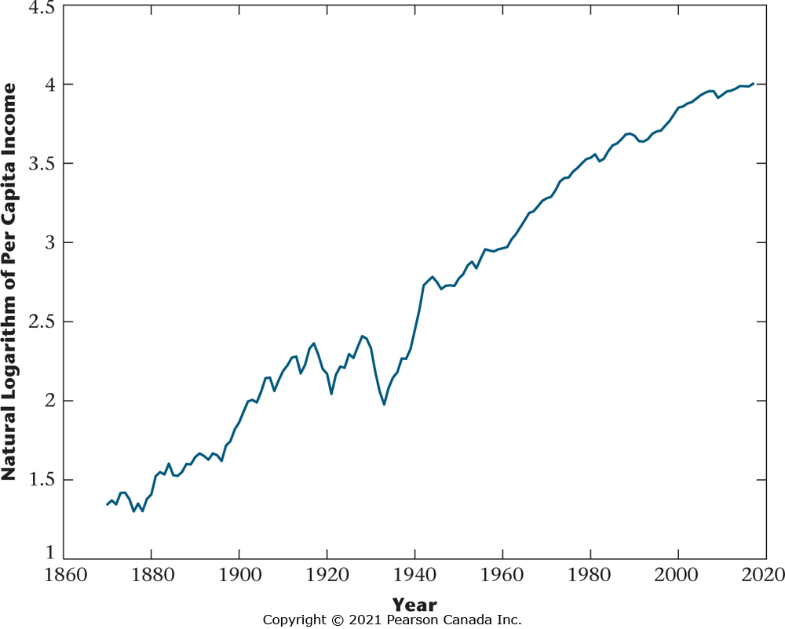
Figure 1.2 Natural Logarithm of Per Capita Real GDP
Here, the slope of the graph is approximately equal to the growth rate of per capita GDP. Excluding the period from 1920 to 1945, the growth rate of per capita GDP is remarkably close to being constant during this period. That is, a straight line would fit the graph fairly well.

Slide 7
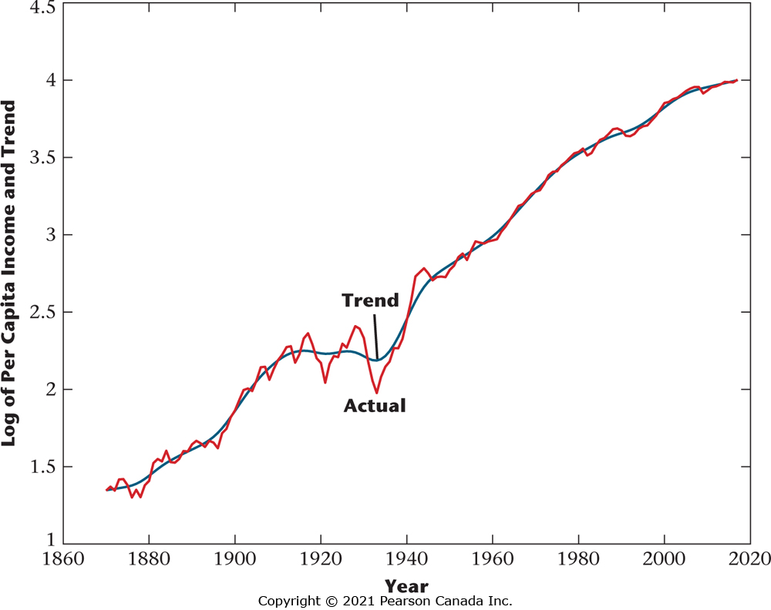
Figure 1.3 Natural Logarithm of Per Capita GDP and Trend
Sometimes it is useful to separate long-run growth from business cycle fluctuations. In the figure, the
black line is the log of real per capita GDP, while the coloured line denotes a smooth growth trend fit to the data. The deviations from the smooth trend then represent business cycles.

Slide 8
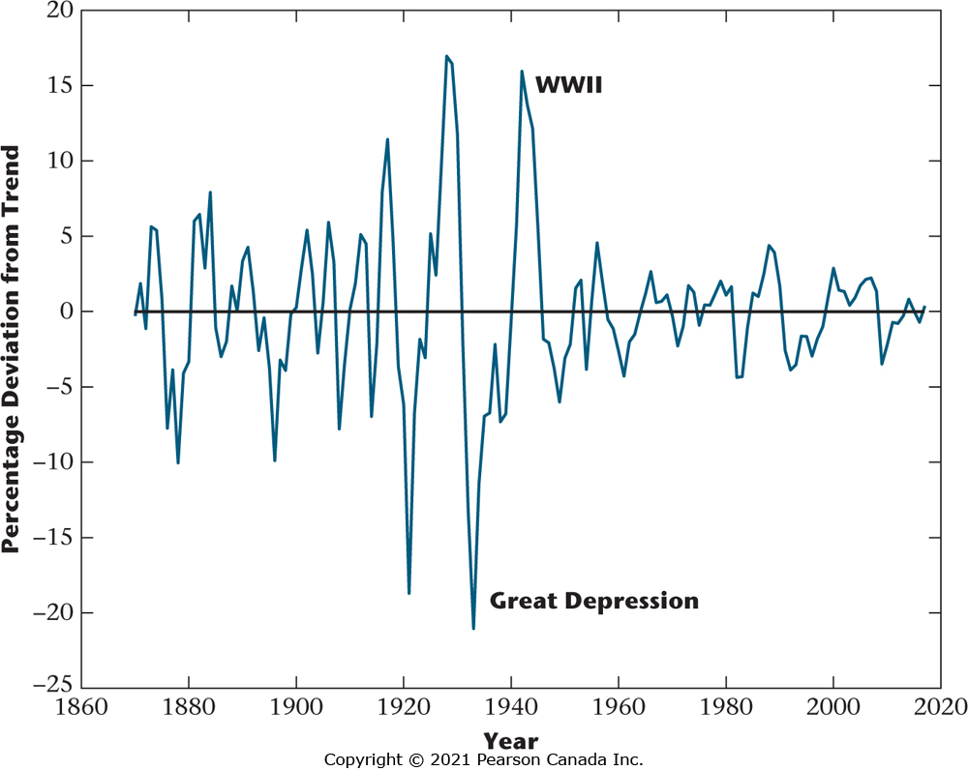
Figure 1.4 Percentage Deviations from Trend in Per Capita GDP
Note the reduction in the volatility of real per capita GDP since World War II.

Slide 9
Macroeconomic Models
A macroeconomic model captures the essential features of the world needed to analyze a particular macroeconomic problem.
Macroeconomic models should be simple, but they need not be realistic.

Slide 10
Basic Structure of a Macroeconomic Model
Consumers and firms
The set of goods that consumers consume
Consumers’ preferences
The production technology
Resources available

Slide 11
What do we learn from macroeconomic analysis?
What is produced and consumed in the economy is determined jointly by the economy’s productive capacity and the preferences of consumers.
In free market economies, there are strong forces that tend to produce socially efficient economic outcomes.
Unemployment is painful for individuals, but it is a necessary evil in modern economies.
Improvements in a country’s standard of living are brought about in the long run by technological progress.

Slide 12
What do we learn from macroeconomic analysis? Part II
A tax cut is not a free lunch.
What consumers and firms anticipate for the future has an important bearing on current macroeconomic events.
What consumers and firms anticipate for the future has an important bearing on current macroeconomic events.
Money takes many forms, and having it is much better than not having it. Once we have it, however, changing its quantity ultimately does not matter.
Business cycles are similar, but they can have many causes.

Slide 13
What do we learn from macroeconomic analysis? Part III
Countries gain from trading goods and assets with each other, but trade is also a source of shocks to the domestic economy.
In the long run, inflation is caused by growth in the money supply.
Two key relationships concerning macroeconomic variables involve the short run tradeoff between output and inflation, and the relationship between the nominal interest rate and inflation.

Slide 14
Understanding Recent and Current Macroeconomics Events
Productivity Growth
Government Spending and Government Surplus
Unemployment
Inflation
Interest Rates
Trade and the Current Account Surplus
Business Cycles

Slide 15
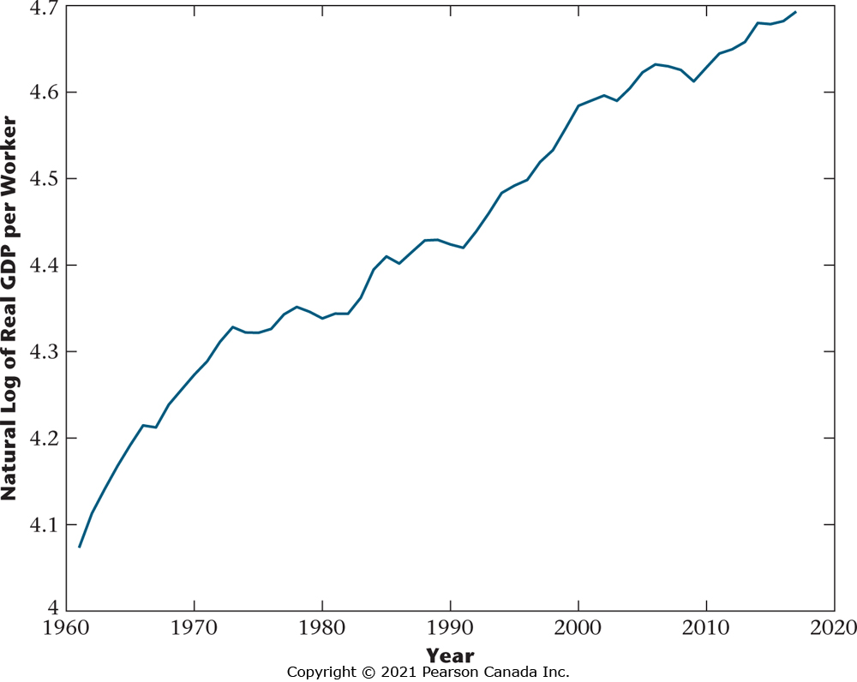
Figure 1.5 Natural Logarithm of Average Labour Productivity
Average labour productivity is the quantity of aggregate output produced per worker. Because the graph is of the log of average labour productivity, the slope of the graph is approximately the growth rate in average labour productivity. Productivity growth slowed from the early 1970s to the early 1980s, and later on, after 2000.

Slide 16
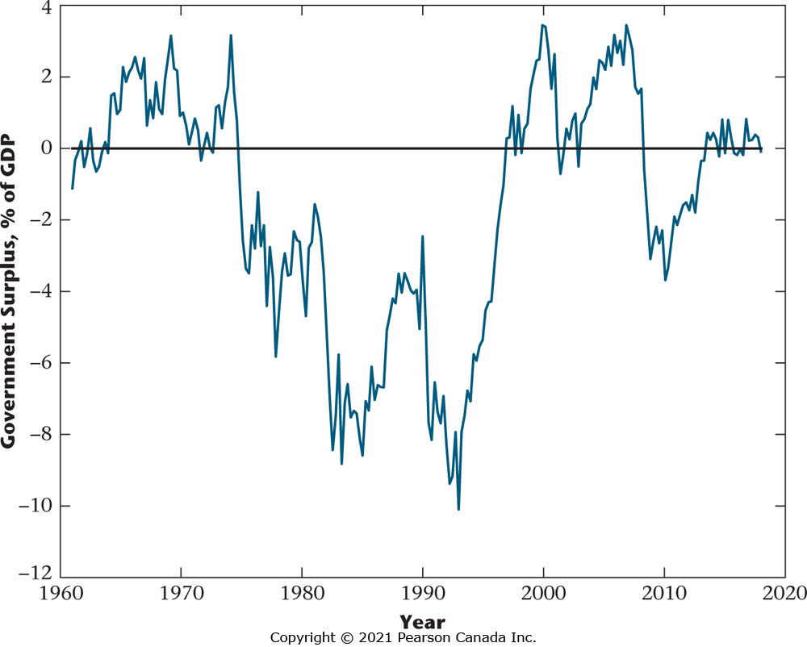
Figure 1.6 The Total Government Surplus in Canada, as a Percentage of GDP
Of particular note is the trend decrease that occurs in the government surplus until the early 1990s, with the government surplus being negative for most of the period since the mid-1970s. The government surplus increases through most of the 1990s and becomes positive in the late 1990s. A deficit opens up in the 2008–2009 recession and the surplus is close to zero from 2014 to 2018.

Slide 17
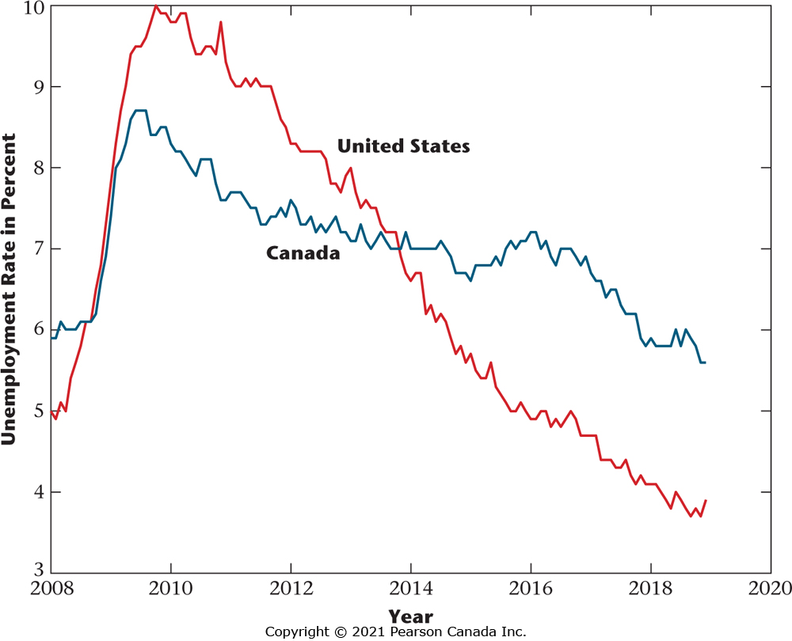
Figure 1.7 Unemployment Rates in Canada and the United States after the Beginning of 2008
The unemployment rate rose much more in the United States than in Canada in the recent recession.
Then, after the recession ended, the unemployment rate fell more quickly in the United States than in
Canada.

Slide 18
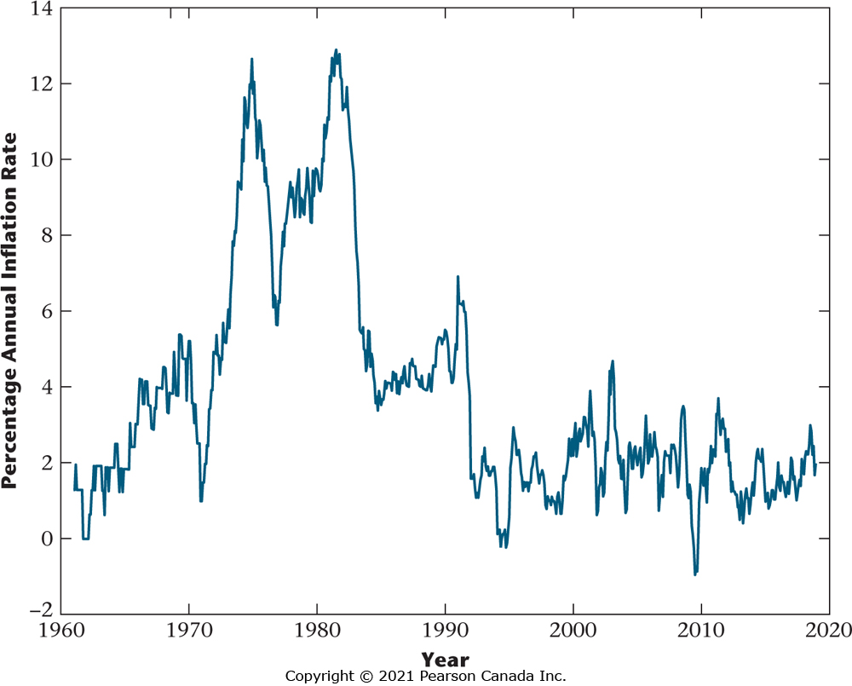
Figure 1.8 Inflation in Canada
The high inflation of the 1970s was brought down by the policies of the Bank of Canada, particularly inflation targeting, which was introduced in 1991.

Slide 19
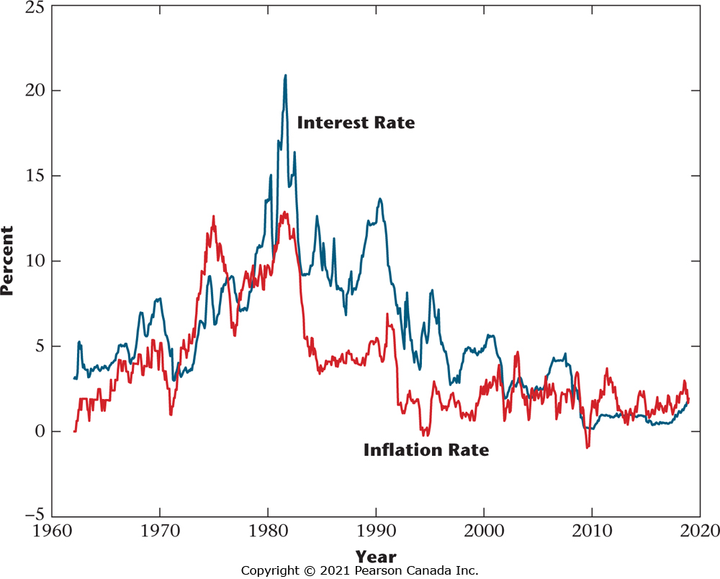
Figure 1.9 The Nominal Interest Rate and the Inflation Rate
Macroeconomic theory tells us that the nominal interest rate and the inflation rate are positively related.
In the figure, the nominal interest rate, which is the three-month Treasury bill rate (a short-term interest
rate on federal government securities) tends to track the ups and downs in the inflation rate.

Slide 20
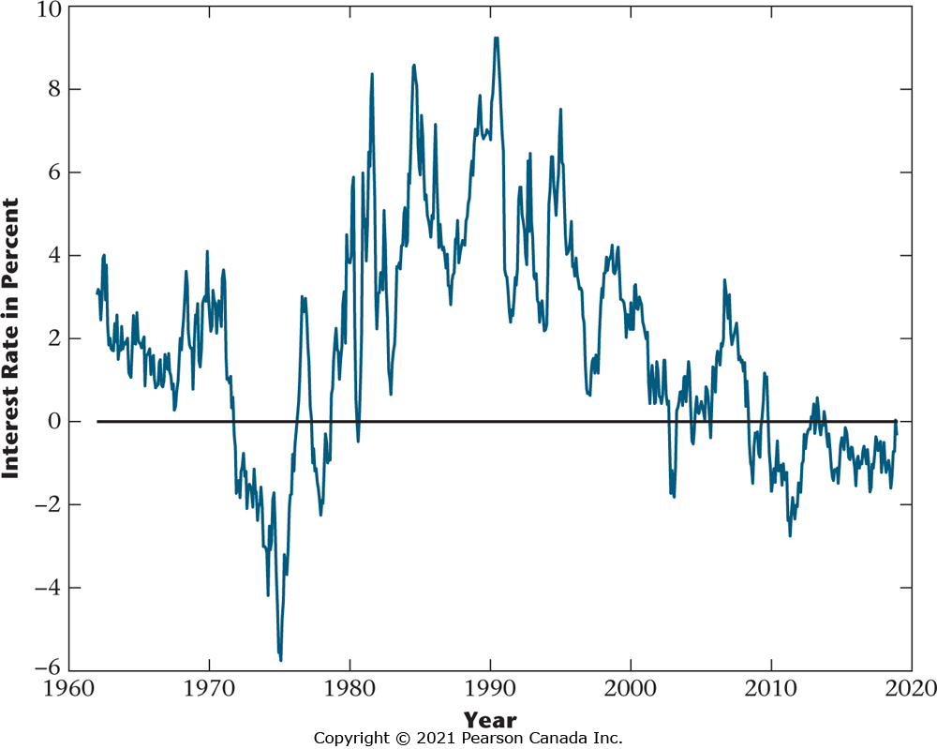
Figure 1.10 Real Interest Rate
The figure shows a measure of the real interest rate, which here is the short-term nominal interest rate
minus the actual rate of inflation. Monetary policy can have a short-run effect on the real interest rate; for
example, the high real interest rates in the 1980s are often attributed to tight monetary policy. Monetary
policy has been quite accommodative since the last recession, with low or negative real rates.

Slide 21
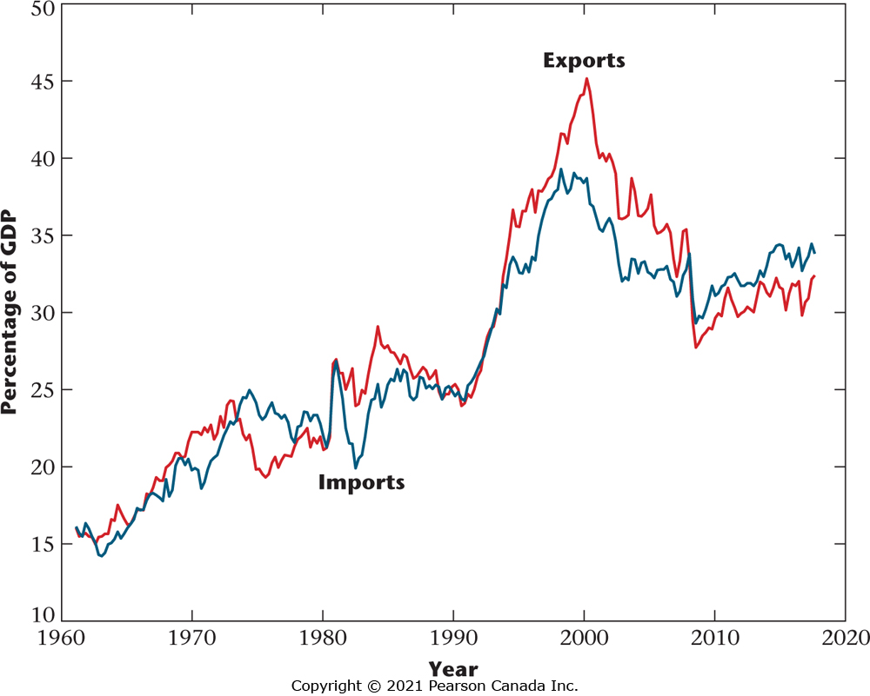
Figure 1.11 Exports and Imports of Goods and Services for Canada, as Percentages of GDP
The increase in both imports and exports reflects a general increase in world trade, though exports and imports both fell from 2000 to 2018.

Slide 22
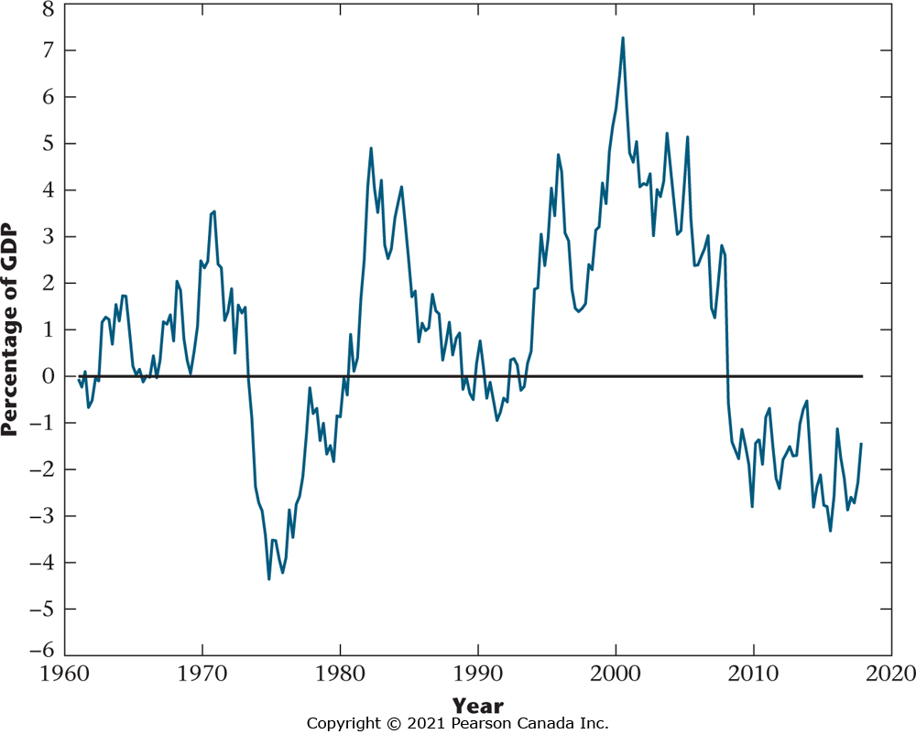
Figure 1.12 Net Exports for Canada, 1961–2018
The figure shows the current account surplus for Canada from 1961 to 2018, which is exports of goods and services minus imports of goods and services, here plotted as a percentage of GDP. Canada ran a trade deficit for much of this period, but began to run a surplus in the late 1990s, with a deficit opening up in the 2008–2009 recession.

Slide 23
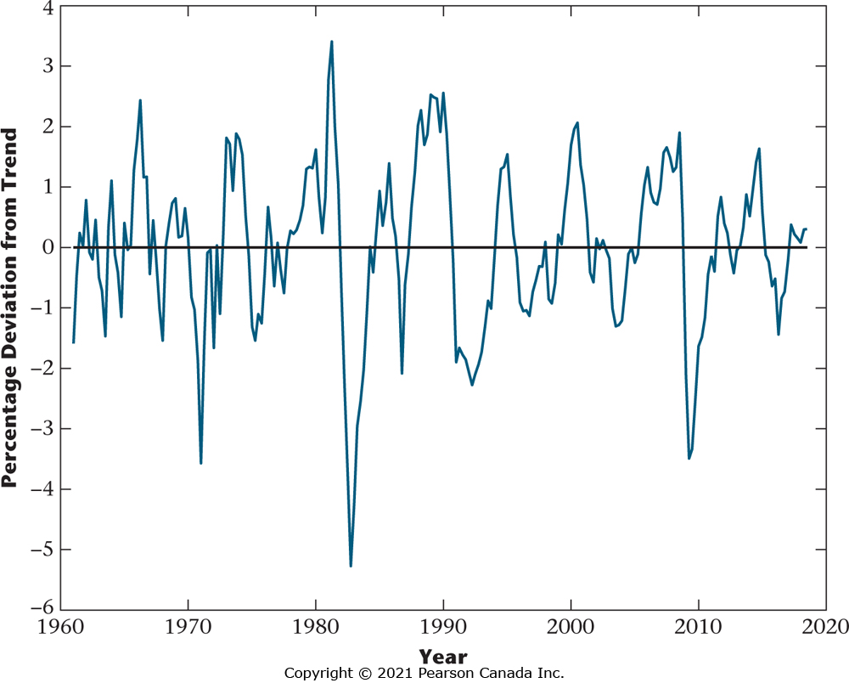
Figure 1.13 Percentage Deviation From Trend in Real GDP
The figure shows business cycles in Canada from 1961 to 2018, as measured by the percentage deviations of real GDP from trend. Note the especially large negative deviations from trend in 1981–1982, 1991–1992, and 2008–2009. These represent particularly severe recessions.

